Slide 1

This slide deck is for presentation only. Do not print for or distribute to customers.

Slide 2
Strands Agents
ANNOUNCING
Open source python SDK for building agents using just a few lines of code

Slide 3
Enterprises are doubling down on agents
33%
15%
of enterprise software apps will include agentic AI by 2028, up from less than 1% in 2024.
of day-to-day work decisions will be made autonomously through agentic AI by 2028.
Gartner, “Top strategic Technology Trends for 2025,” October, 2024.
Gartner, “Top Strategic Technology Trends: agentic AI – The evolution of Experience” February 2025
Notes:
In fact, according to Gartner, they predict over a third of all enterprise apps will be powered by genAI and agentic AI by 2028
And at least 15% of work decisions will be made autonomously by agentic AI by 2028, as compared to 0% in 2024.
Also, by 2028, one-third of interactions with generative AI (GenAI) services will invoke action models and autonomous agents for task completion
Transition: But this evolution isn’t a roadmap of the future. It’s already happening today.

Slide 4

The reality of building AI agents
Steep learning curve
Lack of control and flexibility
Limited visibility
Challenging to build and maintain
Notes:
While the potential of agents is exciting, Customers have told us they face several challenges when trying to build production-ready AI agents. Developers face primary challenges when building reliable agents including 1/ steep learning curve; 2/ enterprise and production readiness; and 3/ managing complex orchestration logic. 2/ lack of visibility, controls; 3/ not enough flexibility

Slide 5
There’s a better way

Slide 6

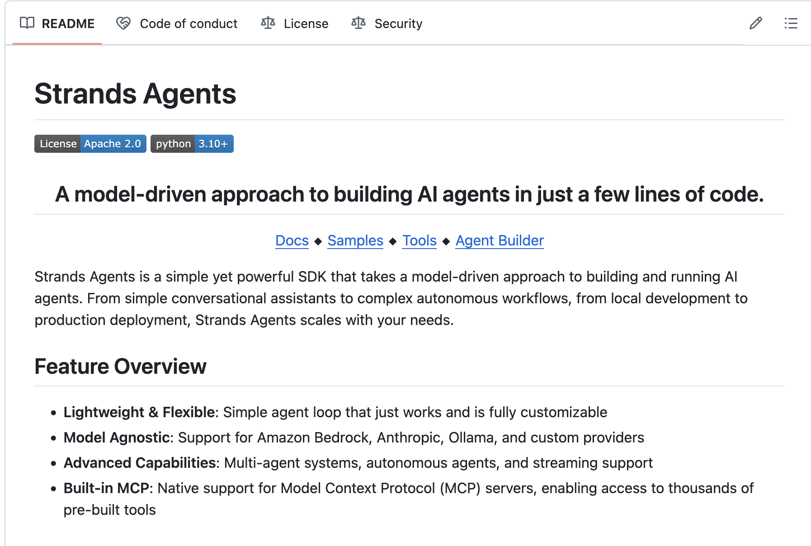
< Hello, World! >
Strands Agents
Strands Agents is an open source python SDK for building agents using just a few lines of code
Notes:
Why did we build? By open-sourcing, we aim to provide developers with powerful, flexible tools to build agents in the rapidly evolving agent landscape.
We are excited to announce Strands Agents, an open source python SDK for building agents using just a few lines of code. It is simple to use and eliminates the need for complex agent orchestration by embracing the capabilities of state-of-the-art models to plan, chain thoughts, call tools, and reflect. Phoenix provides a simple, code-first solution to building agents. With Phoenix, developers can simply define a prompt and a list of tools in code to build an agent, then test it locally and deploy it to the cloud. Phoenix plans the agent's next steps and executes tools using the advanced reasoning capabilities of today's models. For more complex agent use cases, developers can customize their agent's behavior in Phoenix.

Slide 7


OUR VISION
To provide the best place to build and deploy the most trusted and performant agents in the world
7
Notes:
Not only are we building an infrastructure that’s capable of supporting thousands, to millions of agents,
But we’re also investing in making AWS the best place to build and deploy the most trusted and performant agents in the world, [CLICK]

Slide 8

The broadest choice for building and deploying agents
SPECIALIZED
FULLY-MANAGED
DIY
Amazon Q
Pre-built products that use agents for enhanced
productivity
Amazon Bedrock Agents with built-in FM-powered orchestration
Strands Agents
Simple, flexible, and lightweight open source SDK for building agents
OUT-OF-THE-BOX AGENTS
TOOLS FOR BUILDING AGENTS
Notes:
AWS meets you where you are in your agentic AI journey. Our vision is to provide the best place to build and deploy the most trusted and performant agents in the world
Whether through custom development, ready-made solutions, or a combination of both, AWS offers the solution you need to realize your agentic AI strategy.
To effectively leverage agentic AI, you should align your strategy with your desired level of customization and control.
The approach offers three main paths: Specialized, Fully-Managed, and Do-It-Yourself (DIY) agents.

Slide 9
“Using the Strands Agents SDK, the Amazon Q Developer team is building and launching agentic products that previously took months in a matter of weeks.”
3 weeks
4 weeks
6 weeks
CLI AGENTIC CHAT
AGENT CODING EXPERIENCE
AGENTS IN GITLAB DUO
Notes:
Built for developers by developers
IDE agentic chat https://aws.amazon.com/blogs/aws/amazon-q-developer-elevates-the-ide-experience-with-new-agentic-coding-experience/
CLI agentic chat https://aws.amazon.com/blogs/devops/introducing-the-enhanced-command-line-interface-in-amazon-q-developer/
Q Actions https://docs.aws.amazon.com/amazonq/latest/qdeveloper-ug/chat-actions.html
GitLab integration https://about.gitlab.com/press/releases/2025-04-17-gitlab-announces-general-availability-of-gitlab-duo-with-amazon-q/

Slide 10
1
Built for developers: Simple code-first solution to building AI Agents
Design Principles
Model driven approach to agentic development
2
Embrace reasoning capabilities: Allow the agent to perform complex, multistep reasoning and actions
3
Model and Deployment Choice: Enables agents to work across any model provider, support for multiple modalities, and deploy anywhere

Slide 11

Ease of Use: Intuitive agent development to get started in minutes instead of hours
Strands Agents
Robust Capabilities: Native tools, MCP servers, and natively integrated with AWS services
Strands Agents is an open source python SDK for building agents using just a few lines of code
Extensibility: Support for custom model providers, custom tools, and MCP
Rapid Development: Quick prototyping and iteration
© 2025, Amazon Web Services, Inc. or its affiliates. All rights reserved.

Slide 12
Built for builders
Who value flexibility, speed, and simplicity
Model & deployment choice
Model choice
Custom model providers
Deploy anywhere
Highly flexible
Safeguard with guardrails
Native observability
Monitoring
Evaluation
Broad selection of tools
MCP integration
Custom tools
Coordinate multiple agents
Multi-modal
Fetch web data
Read and write files
Interpret code
Integrations
Use AWS services
LiteLLM
Mem0
RAGAS
Tavily
Langfuse

Slide 13
Strands Agents difference
Why customers choose Strands Agents
Choice
Experience
Trust
Support
Offers the flexibility to integrate, customize, and extend the power of agents.
Get started easily with building agents. Build efficiently with documentation and sample agents.
Build agents with responsible AI, native observability, and evaluation in mind.
Get expert advice and collaborate with the AWS Builder and Discord communities, work with Partners, and join AWS Developer events.

Slide 14



Accenture and AWS are helping organizations adopt and scale Agentic AI rapidly and with confidence. Open source is a key part of this strategy. We look forward to leveraging Strands Agents with our clients to develop industry-specific agents that enhance productivity, improve decision-making, and increase operational efficiency. We are also excited to be an active contributor to this open-source community.
Chris Wegmann
Accenture AWS Business Group Global Technology & Practice Lead

Slide 15




Get started with Strands Agents
Start your agentic AI journey today
Docs
Review the user guide, quick start, API documentation for best practices
SDK Get started building agents and contribute to the open-source project on GitHub
Tools
Access pre-built tools to get started experimenting with agents
Samples Discover sample agents in our samples repository
Notes:
Samples: https://github.com/strands-agents/samples
https://github.com/strands-agents/sdk-python https://github.com/strands-agents/docs https://github.com/strands-agents/tools

Slide 16
Thank you

Slide 17
Appendix

Slide 18
Deep dive

Slide 19
Agentic Loop
Enables the agent to perform complex, multi-step reasoning, and actions
Generate a final response
Receive a user input
Strands
Agents
Continue reasoning with new information
Reasoning
Process the input using a language model
Actions
Decide to use tools to gather information or perform actions
Execute the tools and receive results

Slide 20
Model agnostic
Use a variety of LLMs in your agents with minimal configuration
Run open-source LLMs locally without relying on cloud services
Access range of LLMs from LiteLLM providers including OpenAI, Databricks, NVIDIA, and others
Extend agent capabilities with your custom LLM Gateways

Slide 21
Deploy anywhere
Deploy and run agents in any environment where you run Python applications
Deploy on ECS, Lambda, and EC2

Slide 22
Broad selection of tools
Extend agent capabilities by allowing agents to interact with external systems, access data, and more
Expand the tools your agents use by leveraging the custom tool interface
Integrated with MCP servers to extend agent capabilities with tools and services

Slide 23
Highly flexible
Safeguard with guardrails
Native observability
Monitoring
Evaluation
Builder community

Slide 24
Seamless integrations
LiteLLM
Mem0
RAGAS
Tavily
Langfuse

